Slide 1
PYTHON PROGRAMMING PHASE -1
TEAM SPONTANEOUS

Slide 2
DATA TYPES(5 TYPES):
Python Data Types are used to define the type of a variable. It defines what type of data we are going to store in a variable. The data stored in memory can be of many types. For example, a person's age is stored as a numeric value and his or her address is stored as alphanumeric characters.
NUMERIC: INT,FLOAT,COMPLEX
2, 0.5, 2+7I
SEQUENCE TYPE: SET, LIST ,TUPLE
EXAMPLES:
SET={1,2,3,4,5}
LIST=[1,2,”list”,(1,2),3]
TUPLE=(1,2,3,3,4)
DICTIONARY: {“name”:”raju”,”roll”:123}

Slide 3
LIST:
List is a collection which in ordered and changeable.
Allows Duplicate Members.
List can store collection of elements of any data type.
TUPLE:
Tuple is a collection which in ordered and unchangeable.
SET:
Set is a collection which is unordered, unchanged and unindexed.
No Duplicates members.
DICTIONARY:
Dictionary is a collection which is ordered and changeable.
No duplicated keys are allowed.

Slide 4
Python Operators
Operators are used to perform operations on variables and values.
Python divides the operators in the following groups:
Arithmetic operators
Assignment operators
Comparison operators
Logical operators
Identity operators
Membership operators
Bitwise operators

Slide 5
ARITHMETIC OPERATORS: (+,-,*,%,/)
ASSIGNMENT OPERATORS: (=,+=,-=,*=)
COMPARISION OPERATORS: (==,!=,>,<,>=,<=)
LOGICAL OPERATORS: (AND OR NOT)
IDENTITY OPERATORS: (IS ,IS NOT)
MEMBERSHIP OPERATORS: (IN, NOT IN )
BITWISE OPERATORS: (&,|,~,^)

Slide 6
CONDITIONAL STATEMENTS:
If example:
a = 33 b = 200 if b > a: print("b is greater than a")
Elif example:
a = 33 b = 33 if b > a: print("b is greater than a") elif a == b: print("a and b are equal")
Else example:
a = 200 b = 33 if b > a: print("b is greater than a") elif a == b: print("a and b are equal") else: print("a is greater than b")

Slide 7
Python Loops
Python has two primitive loop commands:
while loops
for loops
The while Loop:
With the while loop we can execute a set of statements as long as a condition is true.
example:
Print i as long as i is less than 6:
i = 1
while i < 6:
print(i)
i += 1

Slide 8
For Loops:
A for loop is used for iterating over a sequence (that is either a list, a tuple, a dictionary, a set, or a string).
With the for loop we can execute a set of statements, once for each item in a list, tuple, set etc.
Print each fruit in a fruit list:
example:
fruits = ["apple", "banana", "cherry"]
for x in fruits:
print(x)

Slide 9
STRINGS:
Strings in python are surrounded by either single quotation marks, or double quotation marks.
A string is a data structure in Python that represents a sequence of characters.

Slide 10
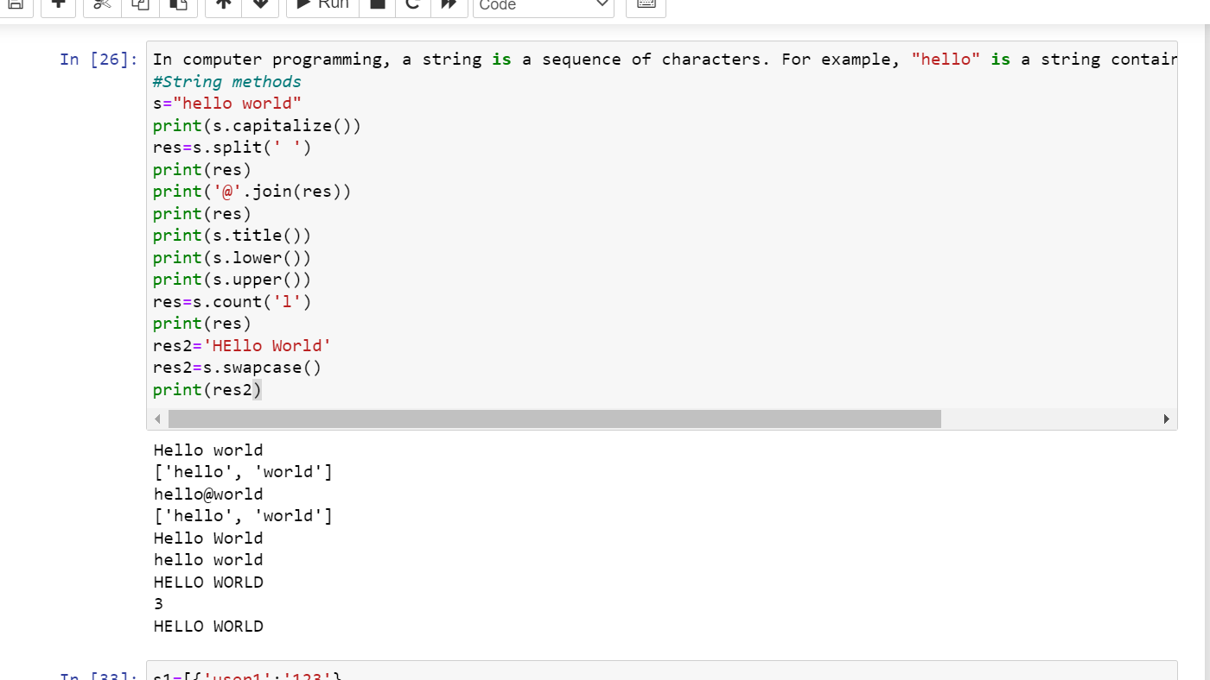
STRING METHODS:

Slide 11
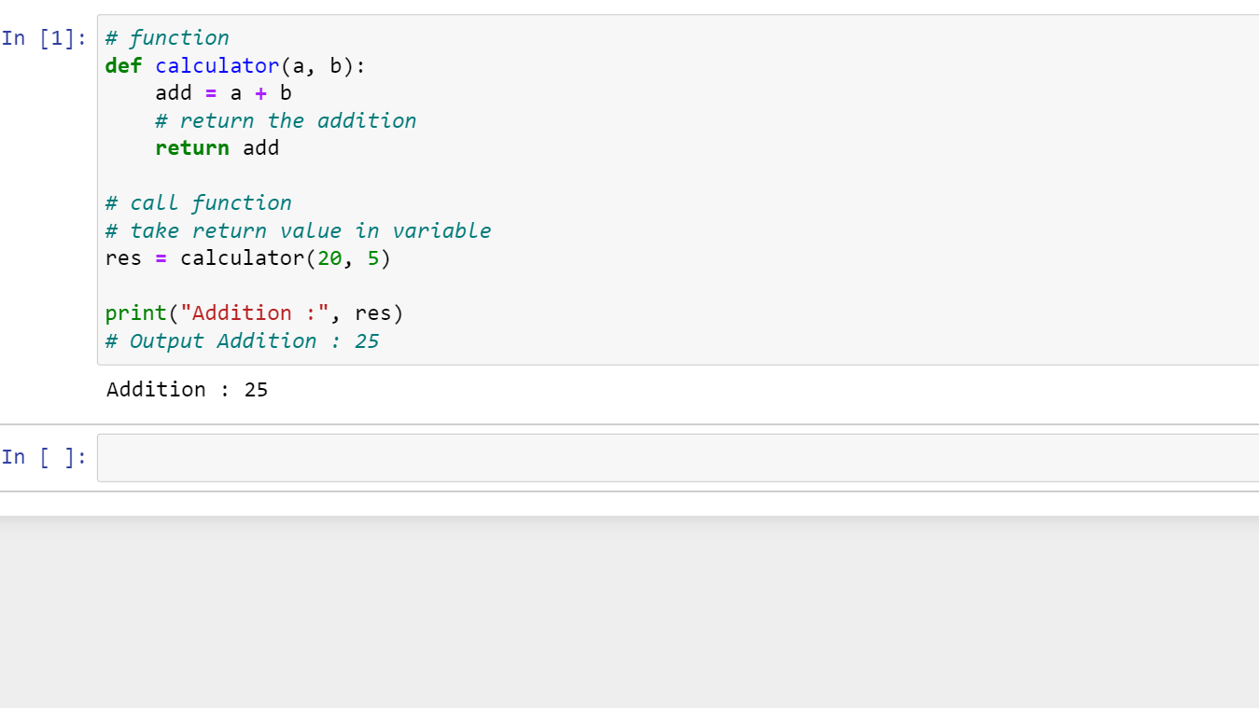
Functions:
Python Functions is a block of statements that return the specific task.

Slide 12
# Driver code
num1, num2 = 5, 15
ans = add(num1, num2)
print(f"The addition of {num1} and {num2} results {ans}.")
Types of Python Function Arguments
Python supports various types of arguments that can be passed at the time of the function call. In Python, we have the following 4 types of function arguments.
Types of Python Function Arguments
Python supports various types of arguments that can be passed at the time of the function call. In Python, we have the following 4 types of function arguments.
Default argument
Keyword arguments (named arguments)
Positional arguments
Arbitrary arguments (variable-length arguments *args and **kwargs)

Slide 13
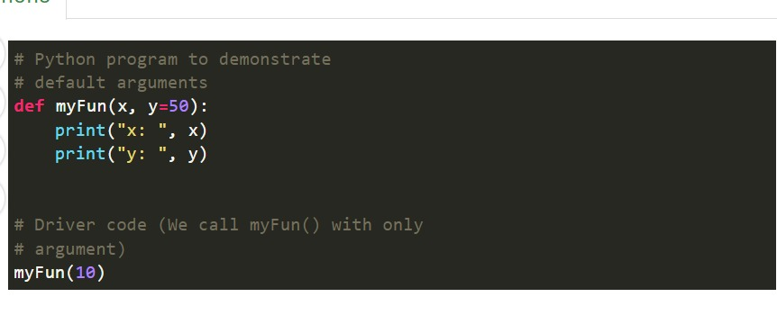
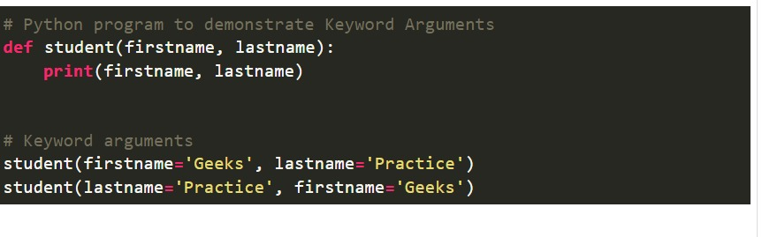

Slide 14
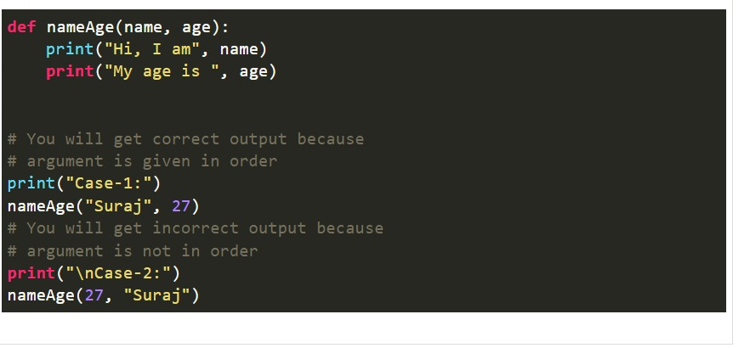
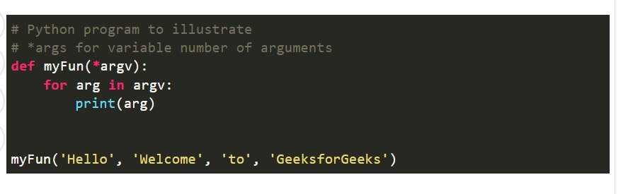

Slide 15
OOP's Concepts in Python
Classes/Objects
Python is an object oriented programming language.
Almost everything in Python is an object, with its properties and methods.
A Class is like an object constructor, or a "blueprint" for creating objects.
Create a Class
Create a class named MyClass, with a property named x:
example
class MyClass:
x = 5
Create Object
Create an object named p1, and print the value of x:
example:
p1 = MyClass()
print(p1.x)

Slide 16
Insert a function that prints a greeting, and execute it on the p1 object:
class Person:
def __init__(self, name, age):
self.name = name
self.age = age
def myfunc(self):
print("Hello my name is " + self.name)
p1 = Person("John", 36)
p1.myfunc()

Slide 17
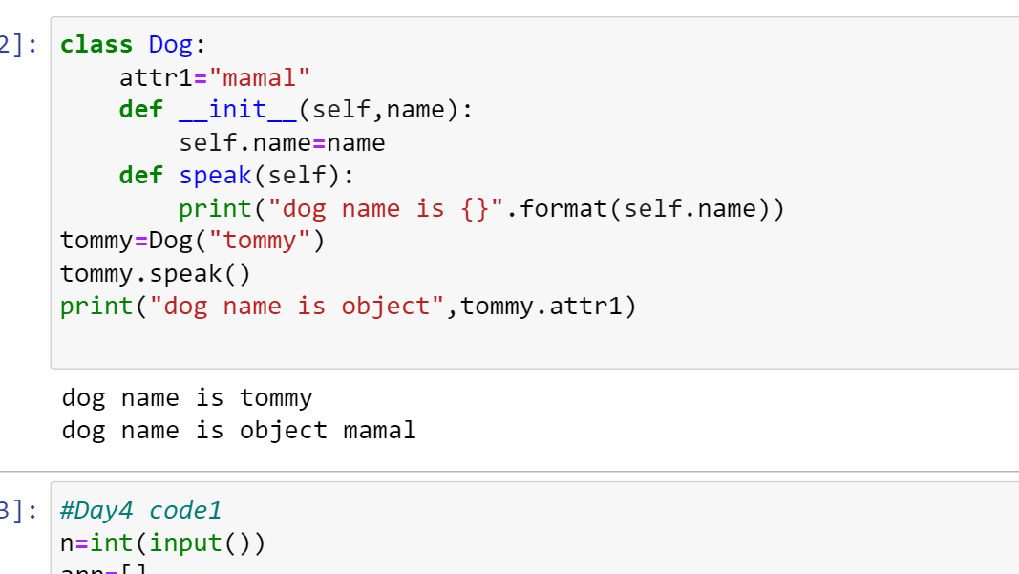

Slide 18
Inheritance
Inheritance allows us to define a class that inherits all the methods and properties from another class.
Parent class is the class being inherited from, also called base class.
Child class is the class that inherits from another class, also called derived class.
class Person:
def __init__(self, fname, lname):
self.firstname = fname
self.lastname = lname
def printname(self):
print(self.firstname, self.lastname)
#Use the Person class to create an object, and then execute the printname method:
x = Person("John", "Doe")
x.printname()

Slide 19
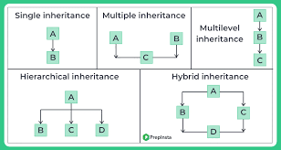

Slide 20
THANK YOU

